Slide 1


System modelling
& Key-value stores (KVS)
SE3331 (2025 Fall)
IPADS, Shanghai Jiao Tong University
https://www.sjtu.edu.cn
Credits: Niv Dayan， JiFei@IPADS

Slide 2
The main topics of today
Answer
Why we need to design key-value systems?
  We’ve already learnt the file abstraction & the file system
What is system modelling, and use it as a tool for motivating the new systems for the key-value abstraction
Building key-value store systems efficiently & analyze their design choices w/ system modelling
  Various techniques, e.g., log-structured, B+Tree, LSM, etc. How did they evolve in this way?

Slide 3
What is a key-value store abstraction?

Slide 4

Recall: Different storage systems to support different type of data
Database
File system
Key-value store

Slide 5
Key-value vs. File: From an abstraction level
Key-value
  A data (value) is named by a key (u64 or String)
  Get(K) -> V, Scan(K,N), Update(K,V), Insert(K,V), Delete(K,V)
File
  A piece of data indexed by a name
  The files can be grouped by directories, in companion w/ management APIs
Key-value vs. File: simpler to use for common application data
Question
  Do we need to implement a complete new key-value system? i.e., Can we directly repurpose the filesystem to support key-value APIs?

Slide 6
Repurpose the filesystem to key-value
Observation: key-value APIs shares similarities as file APIs
Storage abstraction remapping:
  Key → The file name (may include the path)
    Assume the key is not so long
  Value → The file content
Implementing the key-value abstraction
  Get(K) -> V: using OPEN(…) + READ(…)
  Insert/Update(K,V): using CREATE(…) + WRITE(…)
Question: is this way efficient? E.g., high-throughput & low latency

Slide 7
Approaches to answer the question
1. Based on intuition （拍脑袋）
  Pros: fast
  Cons: inaccurate, & relies on expertise
2. Based on experiments
  Pros: accurate
  Cons: inflexible, unable to generalize, the analyze may be slow, unknown whether is the optimal
e.g., suppose I want to insert <key, value> to a system w/ key-value abstraction
  What is the minimal latency that can be achieved?

Slide 8
The desired approach: system modelling
System modelling
  Build an internal abstraction of the system, distill the main components that determine the system behavior (e.g., performance)
  Qualitative models: the abstraction can directly yield performance numbers
Compared w/ intuition
  More concrete, reliable, and accurate
Compared w/ experiment
  More efficient and general
  Note we still need experiments to confirm the model actually works!

Slide 9
A naïve KVS model by directly using a file system model
Implementing the key-value abstraction
  Get(K) -> V: using OPEN(…) + READ(…)
  Insert/Update(K,V): using CREATE(…) + WRITE(…)
K0
K1
…
Kn
File system
Now let’s answer the question!

Slide 10
Using qualitative system models to answer
Define the system requirements (metrics we care)
  Low process latency (& high-throughput)
  Low space usage to support a large volume

Slide 11
Using qualitative system models to answer
Define the system requirements (metrics we care)
  Low process latency (& high-throughput)
  Low space usage to support a large volume
Analysis : take Insert(K,V) as an example
  Our naïve implementation: CREATE(…) + WRITE(…)
1 system call
1 system call

Slide 12
Using qualitative system models to answer
Define the system requirements
  Low process latency (& high-throughput)
  High space utilization
Analysis: take Insert(K,V) as an example (informal)
  Our naïve implementation: CREATE(…) + WRITE(…)
1 system call
1 system call
1 bitmap read + 1 dir read + 1 dir update + 1 dir update + 1 inode update
1 bitmap read/write + 1 inode write + N block writes
Question: What is the ideal performance? (In terms of latency)

Slide 13
Is this implementation efficient?
Analysis: take Insert(K,V) as an example (informal)
  Our naïve implementation: CREATE(…) + WRITE(ptr, size)
1 system call
1 system call
1 bitmap read + 1 dir read + 1 dir update + 1 dir update + 1 inode update
1 bitmap read/write 1 inode write + N block writes
In terms of our previous analyze, it seems No.
  But the real fact is that it depends the workload parameters
  For example, if N is very large, than this implementation is ok ☺

Slide 14
The system model can be parameterized
System modelling
  Build an internal abstraction of the system, distill the main components that determine the system behavior (e.g., performance)
  Qualitative models: models that reflect the performance numbers
A system model typically needs to be parameterized
  The `static` parameters: e.g., the disk read time
  The `input` parameters: e.g., the key-value sizes
  The runtime parameters: more complex & described later

Slide 15
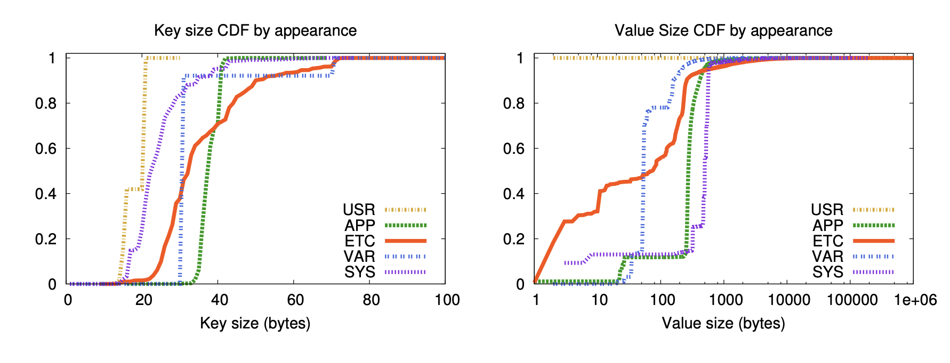
Back to our analyze: what is the input to applications of key-value systems?
Small keys & values are common
  E.g., less than 64B [1]
Key-value store
[1] Source: Workload Analysis of a Large-Scale Key-Value Store, SIGMETRICS’12

Slide 16
Is this implementation efficient? No
Analysis: take Insert(K,V) as an example informal
  Our naïve implementation: CREATE(…) + WRITE(ptr, size)
1 system call
1 system call
1 bitmap read + 1 dir read + 1 dir update + 1 dir update + 1 inode update
1 bitmap read/write 1 inode write + N block writes
Reason: for small key-value sizes <8B, 8B>, the ideal is 1 block writes

Slide 17
Is this implementation efficient? No
Define the system requirements
  Low process latency (& high-throughput)
  High space utilization
Analysis: using one file per-key-value entry is space inefficient
  File data are stored in fixed-sized blocks (e.g., 512B – 4096B)
    Why? To match the underlying device block size & better meta data management
  On the other hand, the value in key-value store can be small (e.g., 16B)

Slide 18
With an appropriate system model, we don’t need to build a system to analyze a solution.

Slide 19
The main topics of today so far
Answer
Why we need to design key-value systems?
  We’ve already learnt the file abstraction & the file system
What is system modelling, and use it as a tool for motivating the new systems for the key-value abstraction
  The model is typically parameterized
Building key-value store systems efficiently & analyze their design choices w/ system modelling
  Various techniques, e.g., log-structured, B+Tree, LSM, etc. How did they evolve in this way?

Slide 20
Key idea: store the <K,V>s in a single file
The system requirements of a key-value system
  Low process latency (& high-throughput)
  High space utilization
By storing the <K,V>s concretely, there is no space wastes
By keeping the file open, we can avoid efficiently read/write the <K,V>s than our priori designs
  E.g., no redundant open calls
  But things are not so easy, e.g., how to implement the Get/Update?

Slide 21
Why we still need a filesystem?
We still need a system to interact with the disk hardware!
  Manage the disk requires considerable engineering efforts
“All problems in computer science can be solved by another level of indirection” -- often attributed to Butler Lampson, who attributes it to David Wheeler
Key-value Store
K0:V0, K1:V1, …
Key-value files
File system
Notes:
<Hints and Principles for Computer System Design>
David Wheeler： 剑桥大学

Slide 22
Step #1: a naïve Key-Value Storage (KVS)
Suppose we store all the KV in a single file in the following format:
Key
Value
123456，'{"name":"London","attractions":["Big Ben","London Eye"]}’
42，'{"name":"San Francisco","attractions":["Golden Gate Bridge"]}’
...

Slide 23
Update(K,V) in the naïve KVS
Suppose we store all the KV in a single file in the following format:
Key
Value
123456，'{"name":"London","attractions":["Big Ben","London Eye"]}’
42，'{"name":"San Francisco","attractions":["Golden Gate Bridge"]}’
...
How to implement the update? Two strategies:
  1. directly modify the file content
  2. append the new updates to the last of the file

Slide 24
How to do the choice? We can derive a system model to analyze.

Slide 25
Key difference: File in-place write vs. File append
In-place write
  1 random disk write
File append
  Common case: 1 sequential disk write
  Corner case: 1 bitmap modification + 1 inode write + 1 sequential write
Question: Which one to choose?

Slide 26
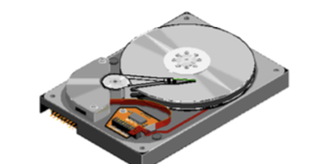
To analyze, we need to add more details to our model
How to implement the update? Two strategies:
  1. directly modify the file content
  2. append the new updates to the last of the file
The key difference lie in how file is modified
  In term of performance, which one is better?
To answer this question, we need model the performance of file in-place write vs. file append
Key-value Store
File system
Disk

Slide 27
Random access vs. Sequential access
HDD performance (for reference)
  Sequential: 100 – 200 MB/s
  Random: 0.5 – 2 MB/s
SSD performance (fore reference)
  Sequential: 2,000 – 3,500 MB/s
  Random: 200 – 300 MB/s
Non-volatile memory is similar ☺

Slide 28
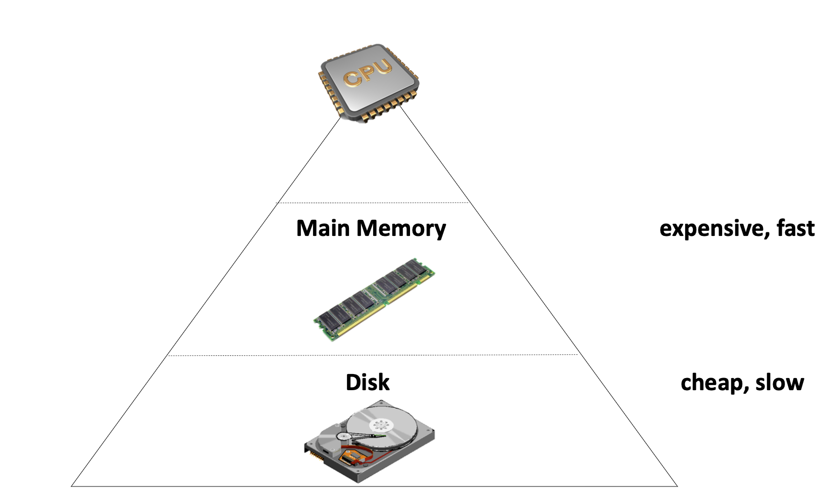
Model the storage hierarchy: data’s place matters!
Fast device (e.g., Main Memory)
  Fast, but capacity is limited
  Expensive
  Volatile
Disk has huge capacity
  Cheap & slow
  Non-volatile

Slide 29
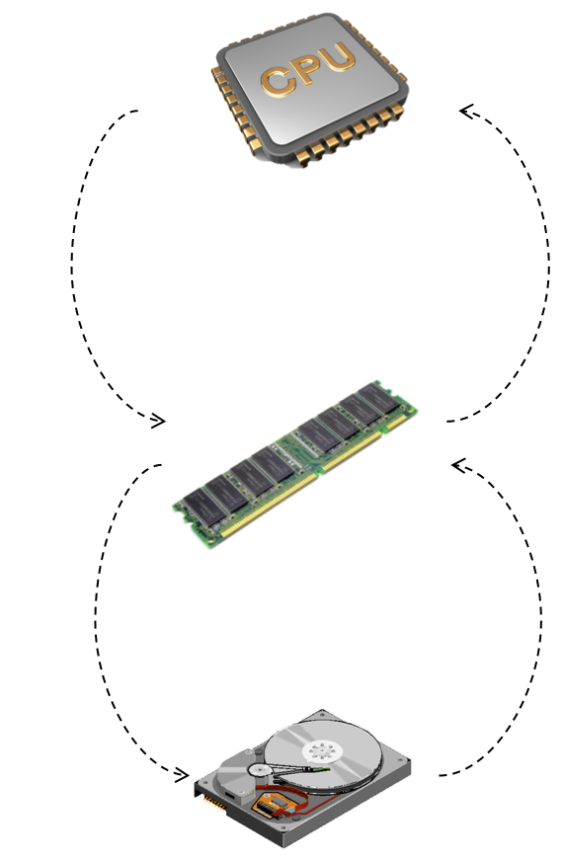
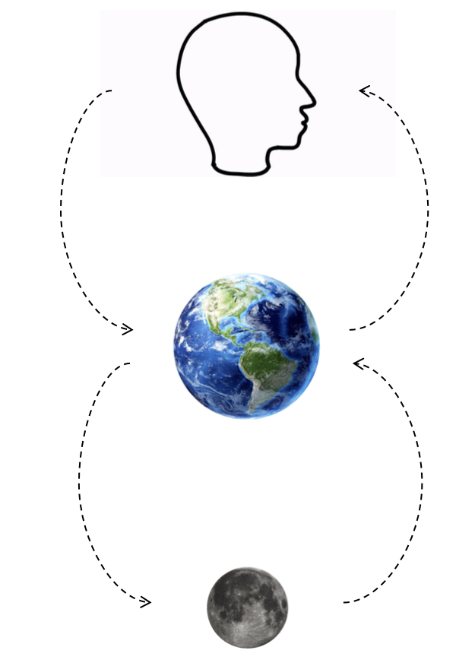
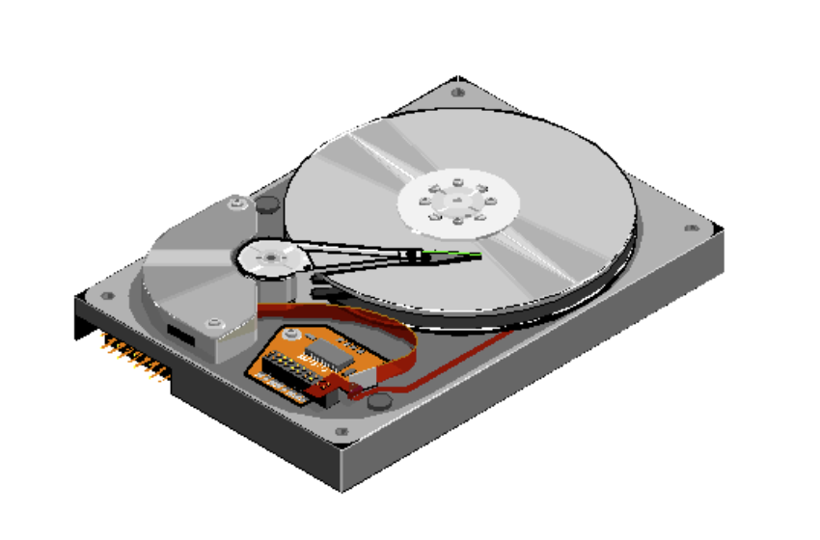
Storage Hierarchy: a quick summary
CPU <-> Memory
  ~= 100ns
Memory <-> Disk
  ~= 10ms
Why disk is slow at random access?
  Random: move disk header, much slower
  Sequential: disk just spins, faster
Disk Header
Notes:
Can use tools like fio to measure.

Slide 30
Update(K,V) in the naïve KVS
Suppose we store all the KV in a single file in the following format:
Key
Value
123456，'{"name":"London","attractions":["Big Ben","London Eye"]}’
42，'{"name":"San Francisco","attractions":["Golden Gate Bridge"]}’
...
How to implement the update? Append is more efficient
  Directly append update to the end of the file
  Benefits: update the file is efficient, especially if there are many updates, because disks are good at sequential writes
  Overwrite the original content introduce slow random accesses

Slide 31
Insert(K,V) in the naïve KVS
Suppose we store all the KV in a single file in the following format:
Key
Value
123456，'{"name":"London","attractions":["Big Ben","London Eye"]}’
42，'{"name":"San Francisco","attractions":["Golden Gate Bridge"]}’
...
How about the insertion? The same s the update
  Question: what about deletion?
    Append a NULL entry and later garbage collected (will talk later)
Notes:
Append a null record at the end of the file

Slide 32
Summarize so far, Step #2: log-structure key-value stores (L-KVS)
The file format is some kind of log file
  We called Log-structured file: an append-only sequence of records
  Most efficient for current computing storage, even for emergency devices like non-volatile memory (NVM)
Widely used in computer systems in scenarios other than KVS
  Suits the performance of underlying hardware (e.g., disk)
  E.g., ensure consistency under failure, etc. (We will see more examples in later lectures)

Slide 33
Updates work well, what about Get(K,V)?
Suppose we store all the KV in a single file in the following format:
Key
Value
123456 '{"name":"London","attractions":["Big Ben","London Eye"]}’
42 '{"name":"San Francisco","attractions":["Golden Gate Bridge"]}’
...
Get is much tricky to implement
  We need to iterate the file line by line starting at the end of file, and then finds the first line whose key matches K
  Terrible performance! Complexity: O(n)

Slide 34
Step #3: L-KVS + index
Extended model
Key-value Store
Solution: extend the model with an index
  An additional structure that is derived from the primary data (e.g., log file)
  Can be added/removed without affecting the primary data
    Only affects the performance instead of correctness
Example of index data structure:
  HashTable
  The inode table in Lab1 is essentially an index
Index: key -> offset
File system
Notes:
Issue: no string key support

Slide 35
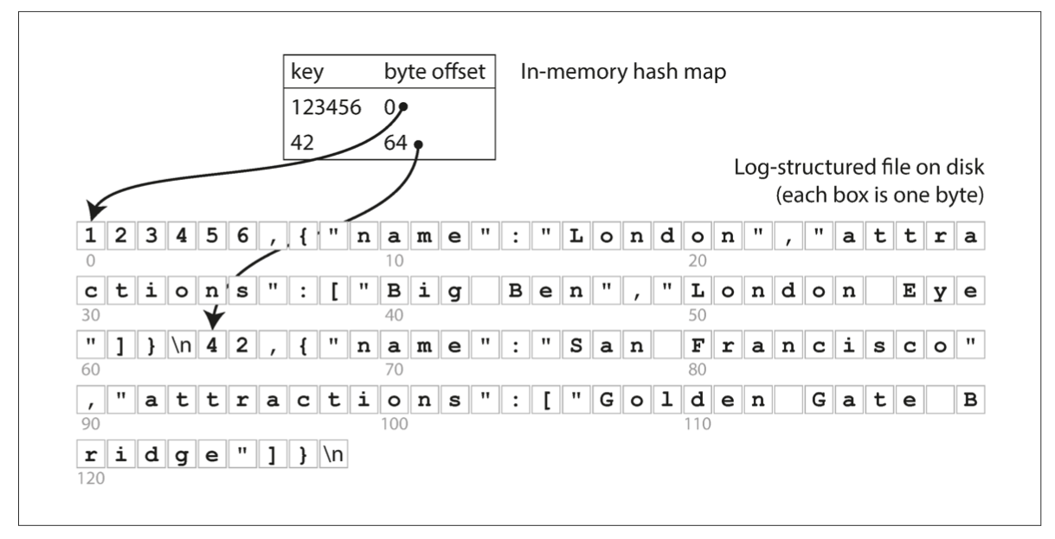
Step #3.1: In-memory hash index + log-structured data file
The simplest possible indexing strategy
  Keep an in-memory hash map that map key -> byte offset in the log file

Slide 36

In-memory hash index + log-structured data file
The simplest possible indexing strategy
  Keep an in-memory hash map that map key -> byte offset in the log file
A viable solution
  Adopted by commercial systems， e.g., Bitcask in riakKV
Benefits
  High-performance of reads/writes
Restriction
  Index must fit into the RAM, which is typically impractical
Question: how to model the performance of Get/Insert/… of Bitcask? Do we need to take the index overhead into account?
Notes:
// 讲下

Slide 37
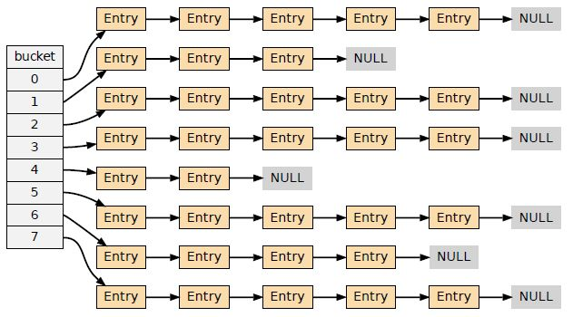
Step #4: L-KVS + (in-memory & disk hybrid index)
In case there are insufficient storage
The placement is fairly simple
  We can use some kind of fat pointer, that can represent both virtual memory address & offset in a file
  Afterward, the index implementation does not need to change ☺
New issue: efficiency
  Index lookup involves disks, which cannot be simply skipped in system modelling!
Index: key -> offset
System model of a bucket-based hashing index: the bucket can be stored both in DRAM & files

Slide 38
Question: how to select a best index for KVS?
Analyze w/ system model (simplified) :
  Insert(N) perf = (index lookup & update) + Value write (N)
Factors related to the index
  #disk accesses per lookup
  Question: is linked-list-based hashing suitable for KVS?
Goal: choose to minimize the lookup times
  Multi KVS per bucket
  Advanced hashing methods, e.g., cuckoo hashing: O(1) per lookup at the cost of expensive insertions

Slide 39
Step #4: L-KVS + (in-memory & disk hybrid hashing index)
System model so far
  Log-structured files to store the KVS
  A hashing index to accelerate the lookups
What are the issues of this model?
  Log file is growing forever -> running out of disk space
  Lack range query support e.g., scan over all keys between kitty00000 and kitty99999
Key-value Store
Index: key -> offset
Index file
File system

Slide 40
How to prevent a file from growing forever?
Log-structured design makes updates fast
  Only append to the file
However, we will eventually run out of disk space
  Since many duplicate records in the log file, we should have space to store more records
  A deleted value is also left on the file

Slide 41
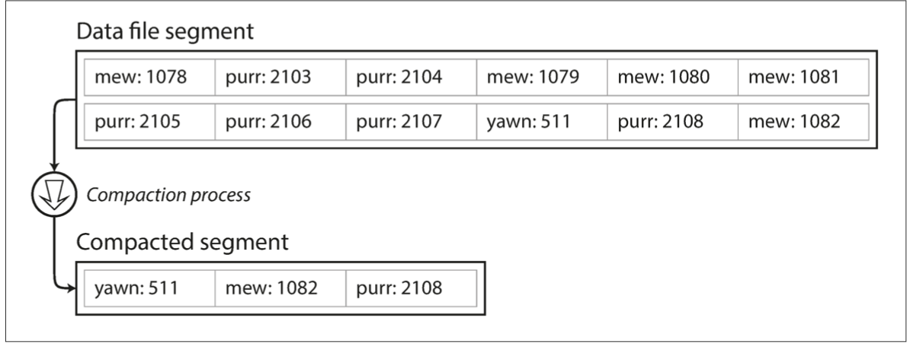
How to prevent a file from growing forever?
Solution: compaction
  Scan the whole file, delete duplicate records and write to a new file
  Question: what if the file is too large?

Slide 42
How to prevent a file from growing forever?
Solution: compaction with segmentation
  Break a file into fixed-sized segments
  If a segment is full, then create a new file for insertions
  Can control the compaction granularity with the segment size
Notes:
遍历文件后面的block并不高效

Slide 43
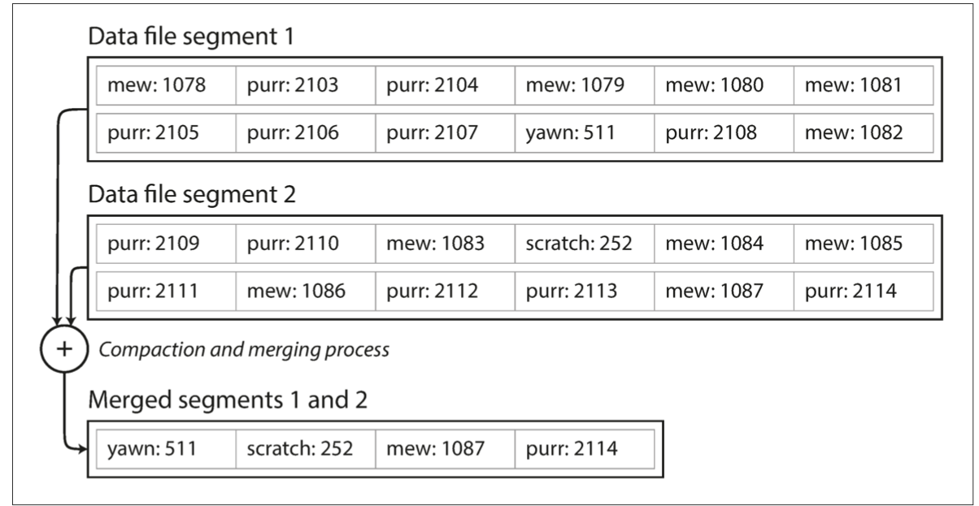
How to prevent a file from growing forever?
Solution: compaction with segmentation + merge
  Compact: remove duplicated records in a segmented file
  Merge: merge two compacted segments into a new one
    Why? Because compaction makes the segment smaller

Slide 44
Recall: how to handle delete() for log-structed file?
Append a NULL entry
Garbage-collected during compaction!
xxxx: null

Slide 45
Question: how does the compaction + merging affect our system model?
Much more complicated to model
  Depends on runtime parameters, e.g., the frequency of compaction/merging, the distribution of the updates
Sometimes ignored in practice
  E.g., can be done in the background
  Still an active research area in more complex scenarios, e.g., LSM-tress

Slide 46
Short recap: the main topics of today so far
Answer
Why we need a key-value abstraction?
  We’ve already learnt the file abstraction & the file system
What is system modelling, and use it as a tool for motivating the new systems for the key-value abstraction
  The model is typically parameterized
  The complexity of the model needs to be incrementally added
Building key-value store systems efficiently & analyze their design choices w/ system modelling
  Various techniques, e.g., log structures, B+Tree, LSM, etc.

Slide 47
Step #4.1: L-KVS (w/ compaction & merging) + (in-memory & disk hybrid hashing index)
System model so far
  Log-structured files to store the KVS
  A hashing index to accelerate the lookups
What are the issues of this model?
  Log file is growing forever -> running out of disk space
  Lack range query support e.g., scan over all keys between kitty00000 & kitty99999
Key-value Store
Index: key -> offset
Index file
File system
Why? Based on our current model, it requires reading all files per-query!

Slide 48

Solution: using B+Tree as the index
Introduced in 1970, the “ubiquitous” index 10 years later for disk data
  Standard data structures of many databases and key-value stores
“It could be said that the world’s information is at our fingertips because of B-trees”
Goetz Graefe Microsoft, HP Fellow, now Google
ACM Software System Award
Notes:
Fingertips: 唾手可得
Goetz Graefe ： SQL server

Slide 49
B+Tree indexes
A B-tree is a tree-like data structure
  Each node is fixed-sized, can store multiple keys, and keys are sorted
  Support efficient range operations (e.g., Scan)
Many variants exist, e.g., B+Tree
  All the leaf nodes of the B-tree must be at the same level
    Simper to link leaf nodes to support range queries

Slide 50
B+Tree indexes example (fanout = 5)
13
2
3
8
13
27
Value location in the log-structured file
Notes:
Fanout：指的是child节点的个数

Slide 51
B+Tree indexes example: Get(2)
13
2
3
8
13
27

Slide 52
B+Tree indexes example: Get(2)
13
2
3
8
13
27

Slide 53
B+Tree indexes example: Update(2)
Similar to Get()
  1. find the position
  2. update the value
13
2
3
8
13
27

Slide 54
B+Tree indexes example: insert(10)
13
2
3
8
13
27

Slide 55
B+Tree indexes example: insert(10)
13
2
3
8
10
13
27

Slide 56
B+Tree indexes example: insert(11)
13
2
3
8
10
11
13
27

Slide 57
B+Tree indexes example: insert(11)
10
13
2
3
8
10
11
13
27
Split the nodes!

Slide 58
Question: need a B+Tree to index the values in the log?
Not necessary. It can store the values in its leaf node
  Which does not need compaction & merge
10
13
2
3
8
10
11
13
27
Value location in the log-structured file

Slide 59
B+Tree in the case of range query
Add a sibling link between the leaves
  e.g., SCAN(3,5)
Performance analyze w/ our system model: O(LogN) + O(5/Fanout) random disk accesses per-query
10
13
2
3
8
10
11
13
27

Slide 60
Put it all together (Step #5): B+Tree-based KVS
Store key-values directly in a B+Tree
  Where each B+Tree node is stored in a file
All KVS operations can be executed in a B+Tree algorithms
10
13
2
3
8
10
11
13
27

Slide 61
Step #5: B+Tree-based KVS, what are the trade-offs?
Get(K), Insert(K,V) and Update(K,V) are slow
  O(log(n)) random disk accesses
  Typically, is small, since B-Tree indexes uses large node size. But is still a killer for performance
B+Tree indexes are not good enough for insertion-intensive workloads
  Still many random disk I/O involved
  Insertions are common for on-disk storages, because reads are served by other system components, e.g., a cache system like Memcached
    E.g., check lecture 04
B+Tree index size can be large
  For small values, the index size can be close to the value sizes (in the same order)
Notes:
// 分析B+Tree 索引的好坏
当然，如果insertion都是在最后，那么b树的性能也是很好的。

Slide 62
Can we avoid random access for
index updates and insertions, with small index size, while supporting scans (no brute force) ?

Slide 63
Recall: segmented log file (For sequential accesses)
Compaction & segmentation
  Break a file into fixed-sized segments
  If a segment is full, then create a new file for insertions
  Can control the compaction granularity with the segment size

Slide 64
Step #6: SSTables (Sorted String Table) KVS
SSTable is based on the segmented log file described before
  Break a file into fixed-sized segments
  If a segment is full, then create a new file for insertion
With two extensions
  Key-values in a segment are sorted by the key
  Old segment files are immutable. SSTables use compaction to save space.
Why immutable? Inserting in a SSTable is not append-only
We will come back to this topic later
Notes:
// 分析B+Tree 索引的好坏

Slide 65
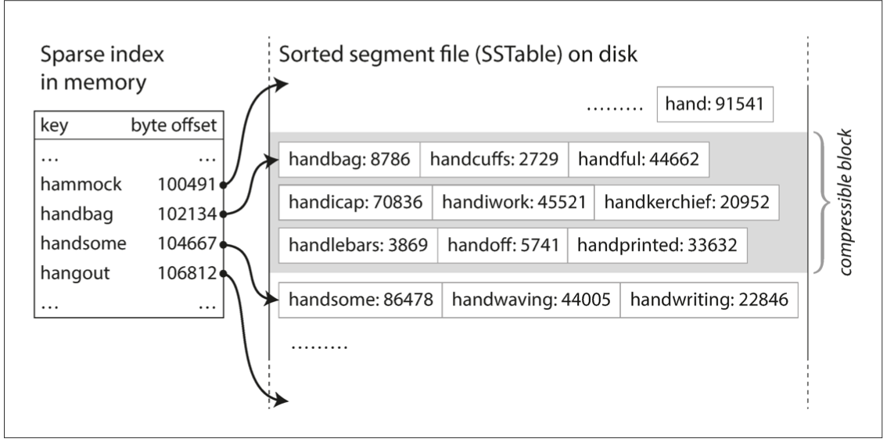
Benefits of SSTable
#1. Searching a given key in a SSTable is efficient
  We can use binary search to lookup a given key
  Or we only need some sparse index for the acceleration, one for each SSTable
  E.g., one key in index for every few KB of SSTable is sufficient, since scanning them is quick

Slide 66
Benefits of SSTable
#2. Support range operations within a SSTable
  Since the KVS are sorted in the file

Slide 67
How to maintain SSTable with sequential writes?
Use a MemTable: an in-memory data structure (e.g., a red-black tree)
  Simple quiz: why not use a hash table?
MemTable

Slide 68
How to maintain SSTable with sequential writes?
Use a MemTable: an in-memory data structure (e.g., a red-black Tree)
Example: insert a (K, V) into SSTable
1
Insert the (K,V) into the MemTable
(K,V)
MemTable

Slide 69
How to maintain SSTable with sequential writes?
Use a MemTable: an in-memory data structure (e.g., a red-black Tree)
Example: insert a (K, V) into SSTable
1
Insert the (K,V) into the MemTable
(K,V)
MemTable
SSTable
2
check whether MemTable exceeds some threshold,
If so, flush it to a new SSTable

Slide 70
How to maintain SSTable with sequential writes?
Use a MemTable: an in-memory sorted data structure (e.g., red-black Tree)
Example: insert a (K, V) into SSTable
3
What if there are too many SSTables?
We can merge & compact them as we have done before with segmented log files
SSTables
Merge & compact
Using a MemTable is essentially an optimization technique called batching

Slide 71
Reads with MemTable + SSTable
Checks the MemTable
If misses, checks the latest SSTable
If still misses, checks the next older SSTable
…
Optimization: keep a sparse in-memory index on each SSTable to accelerate the lookup
1
2
3
4
…
MemTable
SSTables

Slide 72
Organizing SSTables sequentially has several drawbacks
#1. Finding the old value is slow
#2. Deduplication is hard
#3. Range query is still inefficient (worst case needs to scan all the files)
New
Old
1
2
3
4
…
MemTable
SSTables

Slide 73
Step #7: LSM trees
The famous Log-structured merge tree
  Organize SSTables as a hierarchy of trees
Each layer has the entire KVS data of some time
New
  Each layer has maximum size
  Except L0, all files in layers are sorted, and does not have duplicated keys
  Except L0, keys in each layer is sorted according to the SSTable
MemTable
L0
L1
L2
LSM Tree
Old
Notes:
The keys in a layer is sorted

Slide 74
Hierarchy can speed up old value lookup
Each layer has only one file that store the key (except L0)
  So we can search only one file per-layer (not per-file search)
Question: how to find the key file?
  Many methods exist
  E.g., store a [min, max] per file in memory
Read upon lower layers
  First identify the file, then look it!
  O(1) access per layer
MemTable
New
L0
L1
L2
LSM Tree
Old
Notes:
Each layer has only one

Slide 75
Hierarchy can speed up range query
Store a [min, max] per file
Range query
  Query layer-by-layer
  Then merge the results
New
MemTable
L0
L1
L2
LSM Tree
Old
Notes:
Each layer has only one

Slide 76
Range Query in LSM Tree
Search each layer using binary search (or can leverage a sparse index)
Merge the results of each layer
Not as good as B+Tree,
but is much better than hash & logs without hierarchy! !
New
MemTable
L0
L1
L2
LSM Tree
Old

Slide 77
Example: Read in LSM-Tree (Similar to SSTables)
MemTable
Key
Memory
Disk
Level₀
…
…
SSTable
Level₁
KV pairs
(sorted)
…
Level_{k}
…
Metadata

Slide 78
Example: Read in LSM-Tree
MemTable
KV pairs
Memory
Disk
…
Search L0 sequentially
Level₀
…
SSTable
Level₁
KV pairs
(sorted)
…
Level_{k}
…
Metadata

Slide 79
Example: Read in LSM-Tree
MemTable
KV pairs
Memory
Disk
…
Search L0 sequentially
Level₀
…
SSTable
Level₁
KV pairs
(sorted)
…
Level_{k}
…
Metadata
Notes:
为啥L0没有sorted？主要是为了快速将 memtable 刷到 l0里去，不能成为性能瓶颈

Slide 80
Example: Read in LSM-Tree
MemTable
KV pairs
Memory
Disk
Search lower layer using binary search
Level₀
…
…
SSTable
Level₁
KV pairs
(sorted)
…
Level_{k}
…
Metadata

Slide 81
Example: insert/update in LSM-Tree
MemTable
KV pairs
Full
Memory
Disk
Level₀
…
…
SSTable
Level₁
KV pairs
(sorted)
…
Level_{k}
…
Metadata

Slide 82

Example: insert/update in LSM-Tree
MemTable
KV pairs
Memory
Disk
Level₀
…
Compaction
…
SSTable
Level₁
KV pairs
(sorted)
…
Level_{k}
…
Metadata

Slide 83
Summary of analysis of different system models for KVS
Method | Update/Insert efficient | Get efficient | Range Query efficiency | Space efficiency
Log | Yes | No | No | Yes
Log + (in-memory & on-disk hash) | No | Medium | No | Medium
B+Tree | No | Medium | Yes | Medium
LSM tree | Yes | Yes | Medium | Yes
Note: This is a very simple analyze based on our system model
  Because complex systems are hard to model (e.g., corner cases in LSM tree)
Notes:
Example: write stall could affects the update/insert efficiency of LSM tree
Example: if keys exist in many layers, get and range query may become inefficienct

Slide 84
Write stall caused by compaction in LSM Tree
MemTable
KV pairs
Memory
Disk
Level₀
…
…
SSTable
Level₁
KV pairs
(sorted)
…
Level_{k}
…
Metadata

Slide 85
Write stall caused by compaction in LSM Tree
MemTable
KV pairs
Memory
Disk
Level₀
…
…
SSTable
Level₁
KV pairs
(sorted)
…
Level_{k}
…
Metadata

Slide 86
Write stall caused by compaction in LSM Tree
MemTable
KV pairs
Full
Memory
Disk
Level₀
…
…
SSTable
Level₁
KV pairs
(sorted)
…
Level_{k}
…
Metadata

Slide 87
Write stall caused by compaction in LSM Tree
MemTable
KV pairs
Memory
Disk
Level₀
…
Compaction
…
SSTable
Level₁
KV pairs
(sorted)
…
Level_{k}
…
Metadata

Slide 88
Write stall caused by compaction in LSM Tree
MemTable
KV pairs
Memory
Disk
Level₀
…
Compaction
…
SSTable
Level₁
KV pairs
(sorted)
…
Level_{k}
…
Metadata

Slide 89
Write stall caused by compaction in LSM Tree
MemTable
KV pairs
Full
Memory
Disk
Level₀
…
Compaction
…
SSTable
Level₁
KV pairs
(sorted)
…
Level_{k}
…
Metadata

Slide 90
Write stall caused by compaction in LSM Tree
MemTable
KV pairs
Memory
Disk
Level₀
…
Compaction
…
SSTable
Level₁
KV pairs
(sorted)
…
Level_{k}
…
Metadata

Slide 91

Write stall caused by compaction in LSM Tree
  Stalled due to
  slow compaction, hard to model
MemTable
KV pairs
Full
Memory
Disk
Level₀
…
Compaction
…
SSTable
Level₁
KV pairs
(sorted)
…
Level_{k}
…
Metadata

Slide 92
More issues: how to handle failures?
MemTable is an in-memory data structure
  So it is vulnerable to machine failure
Goal: a successful insertion will store the data durably
Solution:
  Keep a separate log file the MemTable (may not be sorted)
  Before inserting to the MemTable, adding the KV to the log first (also a sequential write); reply if the log is successful
  If the machine crashed, reboot it, and reconstruct the MemTable from the log
Impact of failure handling: we need to additionally model the log writes in the performance (this is not the log-structured file!)

Slide 93




LSM Tree Summary
Good when
  Massive dataset
  Rapid updates/insertions
  Fast single-point lookup for recently updated data
  Fits modern KVS workload well so widely adopted in modern single-node key-value stores

Slide 94
LSM Tree Summary
Good when
  Massive dataset
  Rapid updates/insertions
  Fast single-point lookup for recently updated data
  Compared with B-Tree
  Pros: good write performance due to sequential writes
  Cons: additional compaction process, possible slow range queries,
  write stall caused by the compaction, slow lookup for non-existent key

Slide 95
Summary of today’s lecture
Answer
Why we need to design key-value systems?
  We’ve already learnt the file abstraction & the file system
What is system modelling, and use it as a tool for motivating the new systems for the key-value abstraction
  The model is typically parameterized
  The complexity of the model needs to be incrementally added
Building key-value store systems efficiently & analyze their design choices w/ system modelling
  Various techniques, e.g., log-structured, B+Tree, LSM, etc. How did they evolve in this way?

